Slide 1
2014 Interim Results
19 August 2014

Slide 2


Slide 3
Financial Responsibility
Capital investment program - $60m saving
Front End Engineering Design for a large onshore plant – plant costs reduced by 37%
Pipeline project – overall costs reduced by $25m
WGPSN UK contractor day rates – 10% reduction
Looking after our customers’ costs

Slide 4
First half financial headlines
Total revenue up 10% and Total EBITA constant at $244m
Adjusted diluted EPS of 44.4 cents
Strong growth in PSN Production Services led by US shale
Engineering down as anticipated with lower contribution from Upstream
Disappointing performance in Turbine Activities
Interim dividend up 25% on 2013 at 8.9 cents
Continue to anticipate EBITA growth overall in 2014

Slide 5
Delivering on strategy
Performance:
Significant growth in strong long term US shale market
Strong focus on delivering cost efficiencies and adding value for customers
EthosEnergy JV completed in May
Fit:
Establishing engineering capability in key Norwegian market
Further bolt on acquisitions
Risk:
Lower exposure to large fixed price contracts
Collaboration
Malaysia win
Notes:
5

Slide 6
2014 Interim Results – Financial review
Alan Semple - CFO

Slide 7
Financial results
 | H1 2014 $m | H1 2013 $m | Change %
Total revenue¹ | 3,801 | 3,447 | 10.3%
Total EBITA¹ | 244 | 243 | -
EBITA margin | 6.4% | 7.1% | (0.7pts)
Amortisation | (50) | (49)
Total operating profit pre exceptional items | 194 | 194 | -
Net finance expense | (10) | (8)
Profit before tax and exceptional items | 184 | 186 | (1.1%)
Taxation (before exceptional items) | (50) | (51)
Profit before exceptional items | 134 | 135 | (0.7%)
Exceptional Items (net of tax) | 16 | 27
Profit for the period | 150 | 162 | (7.4%)
Adjusted diluted EPS² (AEPS) | 44.4c | 44.5c | -
Dividend | 8.9c | 7.1c | 25%
Note 1: Performance is presented on a proportionally consolidated basis. Total Revenue and Total EBITA presented in these slides include the contribution from joint ventures and activities classified as discontinued, which includes the results of the businesses that transferred to the EthosEnergy joint venture prior to its formation in May. Note 2: Adjusted diluted earnings per share (“AEPS”) is calculated by dividing earnings before exceptional items and amortisation, net of tax, by the weighted average number of ordinary shares in issue during the period, excluding shares held by the Group's employee share ownership trusts and adjusted to assume conversion of all potentially dilutive ordinary shares.
EBITA and AEPS in line with H1 2013

Slide 8
Total revenue and EBITA
 | 1H 2014 $m |  |  |  | 1H 2013 $m
 | Revenue | EBITA | Margin |  | Revenue | EBITA | Margin
Wood Group Engineering | 1,020 | 109 | 10.7% |  | 982 | 120 | 12.2%
Wood Group PSN – Production Services | 2,341 | 163 | 7.0% |  | 1,914 | 111 | 5.8%
Wood Group PSN – Turbine JVs | 422 | 17 | 4.1% |  | 441 | 36 | 8.1%
Dorad/GWF | 18 | (17) |  |  | 110 | 5
Central costs |  | (28) |  |  |  | (29)
Total | 3,801 | 244 | 6.4% |  | 3,447 | 243 | 7.1%
Engineering : lower EBITA contribution from offshore Upstream, partially offset by Subsea & Pipelines
PSN - Production Services: strong growth led by US shale performance at higher margins
PSN – Turbine Activities: disappointing performance in JV’s and losses on Dorad
Notes:
8

Slide 9
Pro forma revenue and EBITA
 | 1H 2014 $m |  |  |  | 1H 2013 $m
 | Revenue | EBITA | Margin |  | Revenue | EBITA | Margin
Wood Group Engineering | 1,015 | 107 | 10.5% |  | 986 | 120 | 12.2%
Wood Group PSN – Production Services | 2,334 | 162 | 6.9% |  | 2,168 | 134 | 6.2%
Wood Group PSN – Turbine JVs | 422 | 17 | 4.1% |  | 446 | 36 | 7.4%
Dorad/GWF | 18 | (17) |  |  | 110 | 5
Central costs |  | (28) |  |  |  | (29)
Pro forma³ | 3,789 | 241 | 6.4% |  | 3,710 | 266 | 7.2%
Acquisitions | 12 | 3 |  |  | (228) | (23)
Constant currency | - | - |  |  | (35) | -
Total as reported | 3,801 | 244 | 6.4% |  | 3,447 | 243 | 7.1%
Note 3: Pro forma Revenue and EBITA have been restated to include the results of acquisitions made in 2013 (Elkhorn, Pyeroy, Intetech) as if they had been acquired on 1 January 2013 and also to apply the average exchange rates used to translate the 2014 results. The 2014 results have been restated to exclude the results of acquisitions made in 2014 (Meesters, Cape, Sunstone).
Production Services EBITA up 21% on a like for like basis
Notes:
9

Slide 10
Cash flow
 | H1 2014 $m | H1 2013 $m | FY 2013 $m
Cash generated pre working capital (excl. JVs)⁴ | 330 | 268 | 574
Working capital movements | (193) | (159) | (65)
Cash generated from operations | 137 | 109 | 509
Acquisitions & deferred consideration | (65) | (17) | (290)
Capex & intangible assets | (68) | (61) | (135)
Interest, tax, dividends & other | (130) | (108) | (264)
Net increase in net debt | (126) | (77) | (180)
Closing net debt (excl. JVs) | (451) | (222) | (325)
JV Net Cash | 24 | 4 | 15
Closing net debt (incl JVs) | (427) | (218) | (310)
Note 4:The cash flow and closing net debt position has been prepared using equity accounting for joint ventures, and as such does not proportionally consolidate the assets and liabilities of joint ventures. The JV cash position is added to arrive at a like-for-like total with that previously reported.
Seasonality reflected in working capital position

Slide 11
ROCE and net debt
 | June 2014 $m | June 2013 $m
Net operating assets⁵ | 3,011 | 2,491
Net borrowings | (451) | (222)
Net assets | 2,560 | 2,269
Non controlling interests | (10) | (9)
Shareholders’ funds | 2,550 | 2,260
ROCE⁶ | 16.0% | 18.1%
Note 5: The balance sheet has been prepared using equity accounting for joint ventures, and as such does not proportionally consolidate the joint ventures assets and liabilities. Note 6: Return of Capital Employed (ROCE) is Total EBITA divided by average capital employed
Average gross debt⁷ | 589 | 392
Average net debt⁷ | 390 | 222
Closing gross debt | 637 | 373
Closing net debt (incl JVs) | 427 | 218
Net Debt:EBITDA | 0.8x | 0.4x
Note 7: Average net and average gross debt is based on the average of the net and gross debt balances respectively at the end of each month
Expect Net Debt:EBITDA typically 0.5-1.5x

Slide 12
2014 Final Results – Operational review
Bob Keiller - CEO

Slide 13
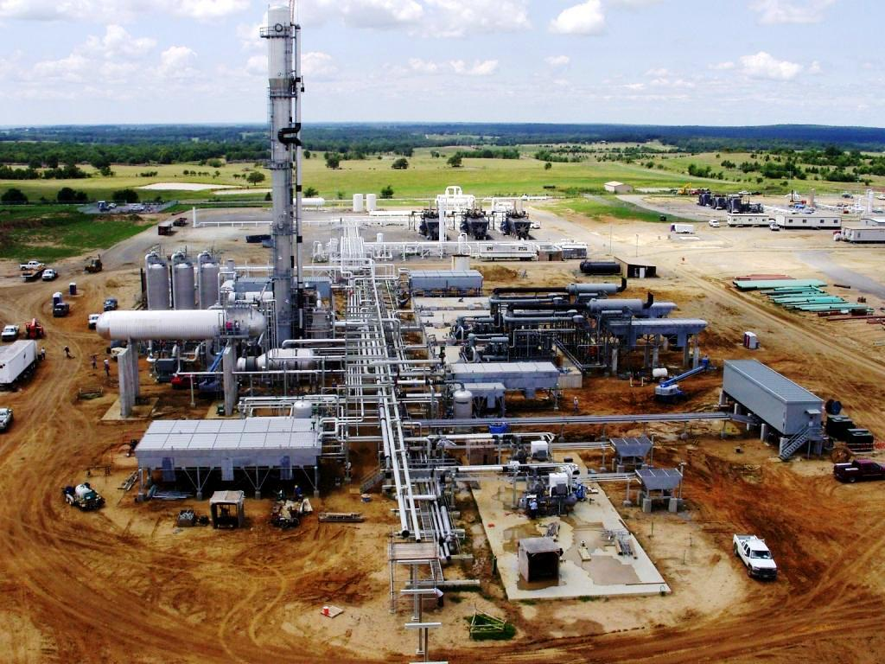
Wood Group PSN – Production Services
 | 1H 2014 $m | 1H 2013 $m | Change %
Revenue | 2,341 | 1,914 | 22%
EBITA | 163 | 111 | 47%
Margin | 7.0% | 5.8% | 1.2pts
Headcount⁸ | 30,000 | 26,300 | 14%
Americas
Growth led by US shale including Elkhorn
Largest contributing region to EBITA
North Sea
Robust performance; benefitting from Pyeroy
Contract renewals and new wins maintain position
Client focus on efficiency and cost
International
Work commenced with Exxon in PNG
New contract award in Malaysia
Oman broadly breakeven; exiting by July 2015
Strong growth in FY 2014 led by US shale activity

Slide 14
Production Services – US shale market
US Shale expenditures to 2022
Current annual revenue of c$1bn
>5000 personnel
Delivering higher margins than in other PSN markets
Services including site preparation, fabrication, installation, commissioning and construction
Further acquisition and capex spend in Bakken and Eagle Ford in H1
Source: Rystad DCube March 2014
Significant long term opportunity in US shale

Slide 15
Wood Group PSN – Turbine Activities
 | 1H 2014 $m | 1H 2013 $m | Change %
Revenue
Turbine JVs | 422 | 441 | (4%)
Dorad/GWF | 18 | 110 | n/m
Total revenue | 440 | 551 | (20%)
EBITA
Turbine JVs | 17 | 36 | (52%)
Dorad/GWF | (17) | 5 | n/m
Total EBITA | - | 41 | n/m
Margin | - | 7.4% | n/m
Headcount | 2,700 | 3,200 | (16%)
Turbine JVs
Comprises EthosEnergy, Rolls Wood Group and TransCanada Turbines
Performance reflects low EPC activity and deferrals
EthosEnergy completed in May – challenging outlook for 2014; taking actions to reduce costs
Dorad
Delayed handover in May contributed to loss in the period
Financial position expected to be largely recovered in H2
Significant improvement in H2 but lower EBITA overall in FY2014

Slide 16
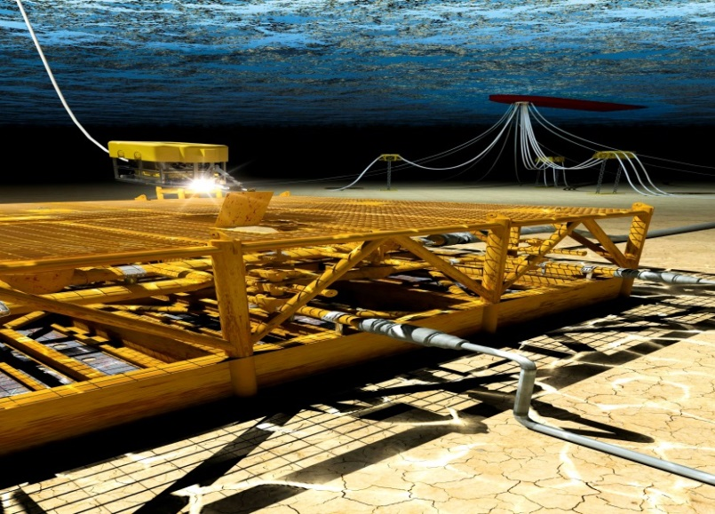
Wood Group Engineering
 | 1H 2014 $m | 1H 2013 $m | Change %
Revenue | 1,020 | 983 | 4%
EBITA | 109 | 120 | (9%)
Margin | 10.7% | 12.2% | (1.5pts)
Headcount | 10,500 | 10,500 | -
Upstream
Lower contribution from offshore and Canada
Working with Agility projects on Ivar Aasen
Slower pace of large offshore greenfield detailed awards
Increased involvement in early stage work
Subsea & Pipelines
Good activity in Europe, Middle East and Caspian
Several new subsea awards
Onshore pipelines benefitting from US shale, Sunstone acquisition
Downstream, process & industrial
Greenfield and brownfield work in refining and chemicals
Subsea & pipelines performance offset by Upstream; overall reduction in EBITA in FY 2014

Slide 17
Summary and outlook
Wood Group Engineering
- lower contribution from offshore work in Upstream
- good performance in Subsea & Pipelines and Downstream
Wood Group PSN – Production Services
- good growth led by US shale
- robust North Sea performance
- exit Oman contract by July 2015
Wood Group PSN – Turbine Activities
- disappointing performance; significant improvement expected in H2
Overall, on track to deliver full year EBITA in line with expectations and up on 2013
17
Notes:
17

Slide 18
Footnotes
1. Total EBITA represents operating profit including JVs on a proportional basis of $221.5m (2013: $225.7m) before the deduction of amortisation of $50.3m (2013: $48.8m) and exceptional income of $27.9m (2013: $31.3m) and is provided as it is a key unit of measurement used by the Group in the management of its business.
2 Adjusted diluted earnings per share (“AEPS”) is calculated by dividing earnings before exceptional items and amortisation, net of tax, by the weighted average number of ordinary shares in issue during the period, excluding shares held by the Group's employee share ownership trusts and adjusted to assume conversion of all potentially dilutive ordinary shares.
3: Pro forma Revenue and EBITA have been restated to include the results of acquisitions made in 2013 (Elkhorn, Pyeroy, Intetech) as if they had been acquired on 1 January 2013 and also to apply the average exchange rates used to translate the 2014 results. The 2014 results have been restated to exclude the results of acquisitions made in 2014 (Meesters, Cape, Sunstone).
4:The cash flow and closing net debt position has been prepared using equity accounting for joint ventures, and as such does not proportionally consolidate the assets and liabilities of joint ventures. The JV position is added to arrive at a like-for-like total with that previously reported.
5: The balance sheet has been prepared using equity accounting for joint ventures, and as such does not proportionally consolidate the joint ventures assets and liabilities.
6: Return of Capital Employed (ROCE) is Total EBITA divided by average capital employed
7: Average net and average gross debt is based on the average of the net and gross debt balances respectively at the end of each month
8. Headcount includes employees and contractors at 30 June and includes our proportional share of headcount in joint ventures.

Slide 19
Appendix
19
Notes:
19

Slide 20
Reconciliation of operating profit
 | H1 2014 $m | H1 2013 $m
EBIT | 194 | 194
Impact of JV profit included pre vs post-tax | (7) | (7)
Impact of discontinued activities | 4 | (21)
Operating profit per Group Income Statement | 191 | 166
Notes:
20

Slide 21
Exceptional gain
 | H1 2014 $m | H1 2013 $m
Integration and restructuring charges | (30) | -
Lease termination income | - | 15
Bad debt recoveries | - | 2
Business divested in prior years | 58 | 14
Total exceptional gain | 28 | 31
Tax | (12) | (4)
Total exceptional gain after tax | 16 | 27
Notes:
21

Slide 22
Amortisation
 | 1H 2014 $m | 1H 2013 $m
Amortisation on software, development costs and licenses | 19 | 21
Amortisation of intangible assets arising on acquisition
- PSN | 14 | 20
- Other | 17 | 8
 | 50 | 49
Total amortisation charge for 2014 is anticipated to be c.$104m (excluding Agility)
Notes:
22

Slide 23
Tax
 | H1 2014 $m | H1 2013 $m
Profit from continuing operations before tax | 184 | 187
Tax charge | 50 | 52
Effective tax rate on continuing operations | 27.4% | 27.5%
All the above are pre-exceptional items
The tax charge above includes $6m in relation to joint ventures (June 2013: $6m)
Notes:
23

Slide 24
Finance expense
 | 1H 2014 $m | 1H 2013 $m
Interest on debt | 5 | 4
Other fees and charges | 6 | 5
Total finance expense | 11 | 9
Finance income | (1) | (1)
Net finance expense | 10 | 8
Interest cover was 25.7 times (June 2013: 31.2 times).
Total finance expense for 2014 is expected to be just under $25m, including the impact of the US private placement drawdown (excluding Agilty).
Notes:
24

Slide 25
Disclaimer
This document has been prepared by John Wood Group PLC (the Company) solely for use at presentations held in connection with the interim results announcement of 19 August 2014. Neither the information in this document nor any statement made at, or in conjunction with, those presentations have been independently verified, and no representation or warranty, express or implied, is made as to, and no reliance should be placed on, the fairness, accuracy, completeness or correctness of the information or opinions contained herein or at the presentations. None of the Company or any of its affiliates, advisors or representatives shall have any liability whatsoever (in negligence or otherwise) for any loss whatsoever arising from any use of this document, or its contents, or otherwise arising in connection with this document or the presentations. However, nothing in this disclaimer shall serve to exclude liability to the extent that such liability results from fraud including fraudulent misrepresentation.
This document does not constitute or form part of any offer or invitation to sell, or any solicitation of any offer to purchase any shares in the Company, nor shall it or any part of it or the fact of its distribution form the basis of, or be relied on in connection with, any contract or commitment or investment decisions relating thereto, nor does it constitute a recommendation regarding the shares of the Company.
Certain statements in this presentation are forward looking. By their nature, forward looking statements involve a number of risks, uncertainties or assumptions that could cause actual results or events to differ materially from those expressed or implied by those forward looking statements. These risks, uncertainties or assumptions could adversely affect the outcome and financial effects of the plans and events described in this document or statements made at or in conjunction with the presentations. Forward looking statements contained in this document and made at, or in conjunction with, the presentations regarding past trends or activities should not be taken as a representation that such trends or activities will continue in the future. You should not place undue reliance on forward looking statements, which speak only as of the date of the presentation.
The Company is under no obligation to update or keep current the information contained in this document or any statement made at, or in conjunction, with the presentations, including any forward looking statements, or to correct any inaccuracies which may become apparent and any opinions expressed are subject to change without notice.

